Slide 1

Rest API

Slide 2
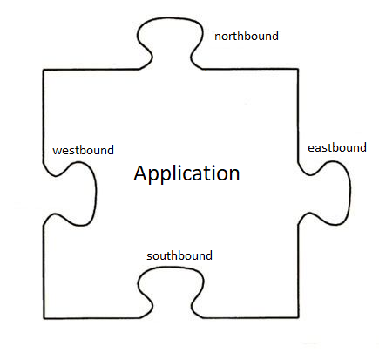
What is an API

Slide 3
Application Programming Interface
Pilars
Limited Access
System-Independent
Simple to use
Docs

Slide 4
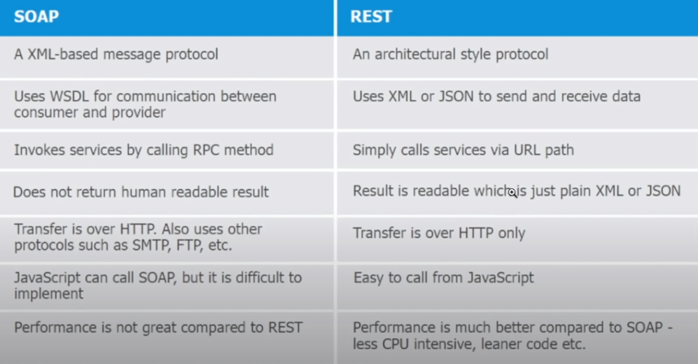
Two types of web API

Slide 5
Characteristics of REST API
1. It is stateless
2. It supports JSON and XML
3. Client-server based architecture
4. Cacheable
5. Error messages
6. Documentation

Slide 6
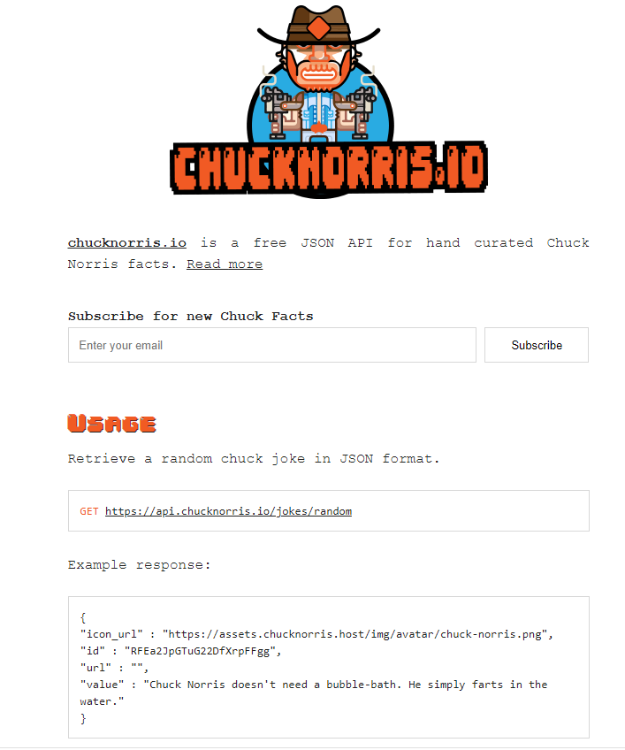
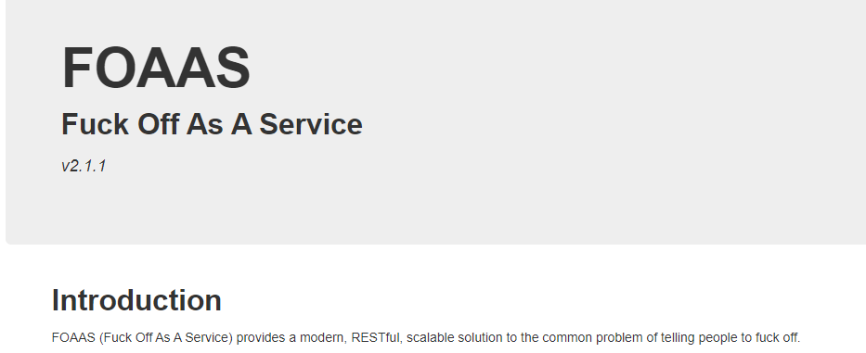
A lot of support

Slide 7

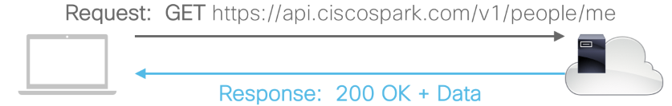
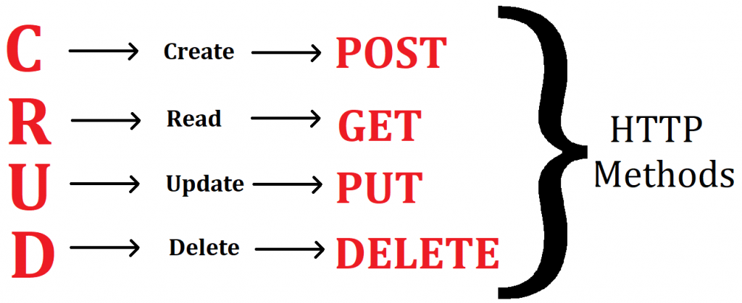
Overview
Status Code | Status Message | Meaning
200 | OK | All looks good
201 | Created | New resource created
400 | Bad Request | Request was invalid
401 | Unauthorized | Authentication missing or incorrect
403 | Forbidden | Request was understood but not allowed
404 | Not Found | Resource not found
500 | Internal Server Error | Something wrong with the server
503 | Service Unavailable | Server is unable to complete request

Slide 8
How to get started
Postman
Doc
https://netbox.readthedocs.io/en/stable/rest-api/overview/
https://developer.cisco.com/meraki/api-v1/
https://developer.cisco.com/docs/sdwan/
https://developer.cisco.com/docs/dna-center/api/1-3-0-x/
https://developers.google.com/gmail/api

Slide 9
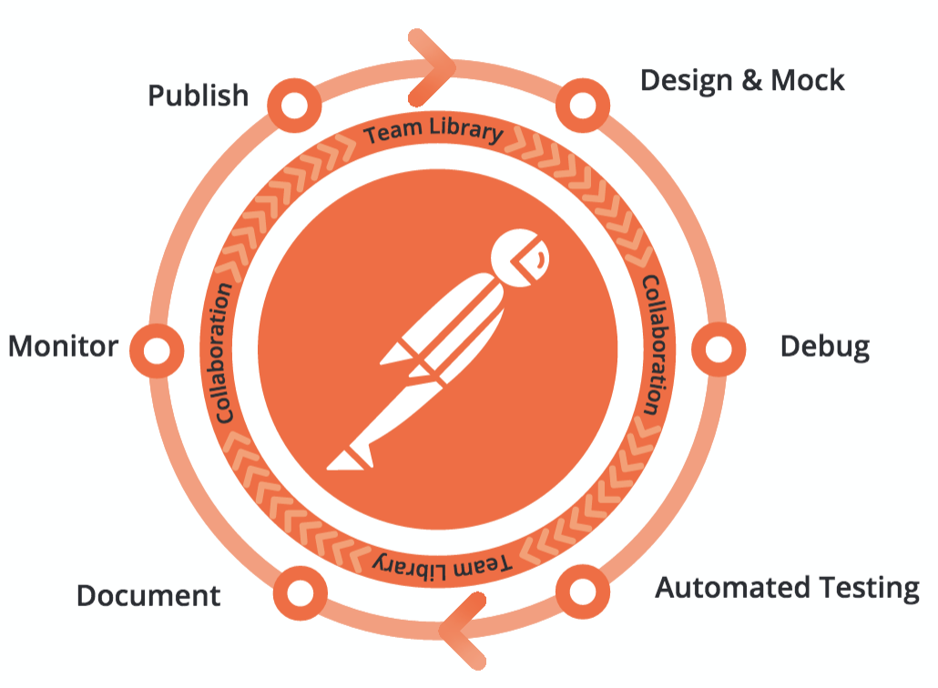
Demo Postman

Slide 10
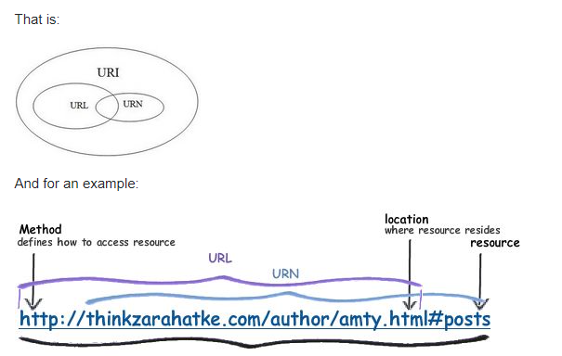
URL, URN, URI

Slide 11
Demo Netbox

